Slide 1

Pedestrian Detection in Thermal Images using Saliency Maps
Debasmita Ghose*, Shasvat Desai*, Sneha Bhattacharya*, Deep Chakraborty*, Madalina Fiterau, Tauhidur Rahman
[16 June], 2019
* Authors contributed equally

Slide 2
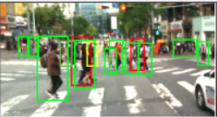
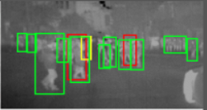
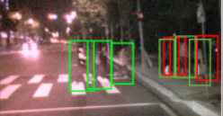
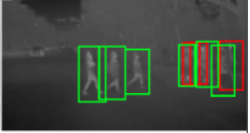
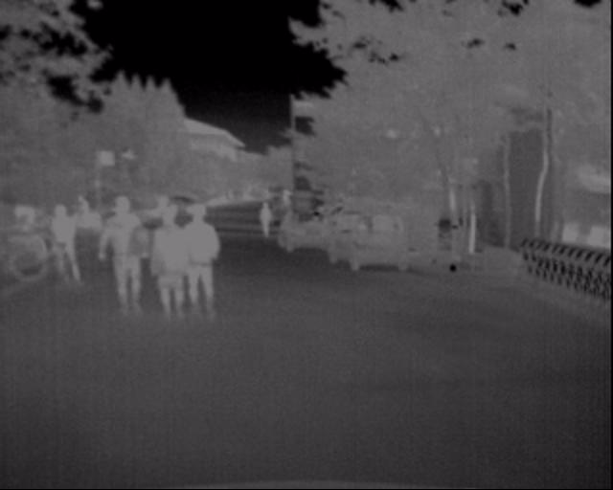
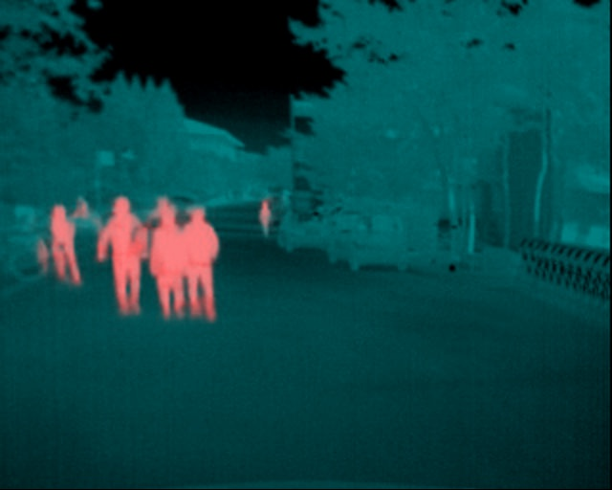
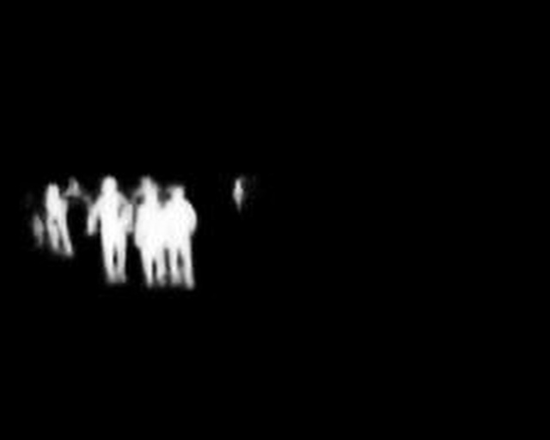
INTRODUCTION
${\text{Color}\text{-}\text{Thermal} \text{image} \text{pairs} \text{from} \text{KAIST} \text{Multispectral} \text{Pedestrian} \text{Dataset}}^{1}$
Day
Night
Thermal Images
Saliency Maps
+
=
Fused Image
1. Hwang, Soonmin, et al. "Multispectral pedestrian detection: Benchmark dataset and baseline." Proceedings of the IEEE conference on computer vision and pattern recognition. 2015.

Slide 3
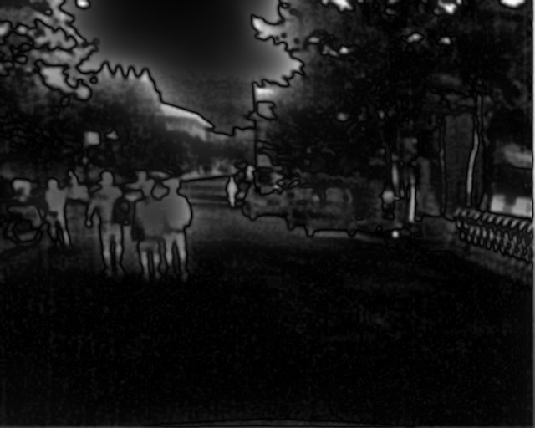
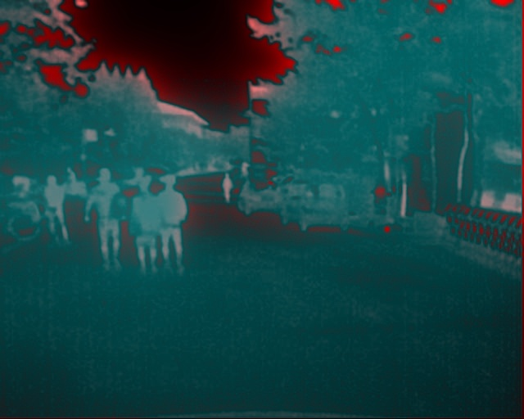
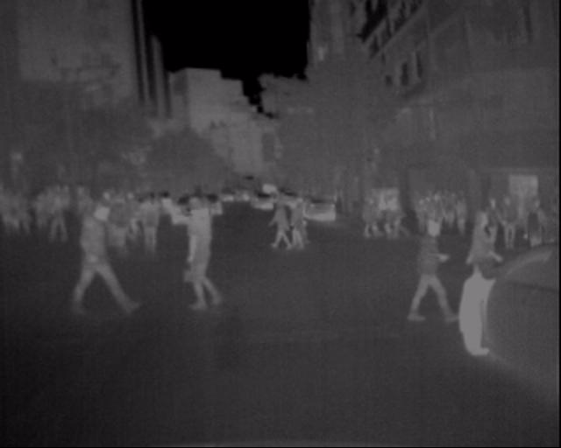
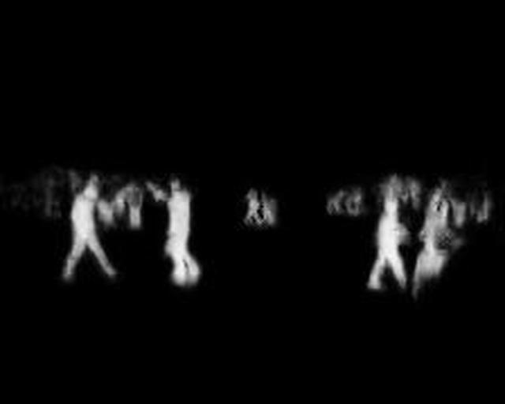
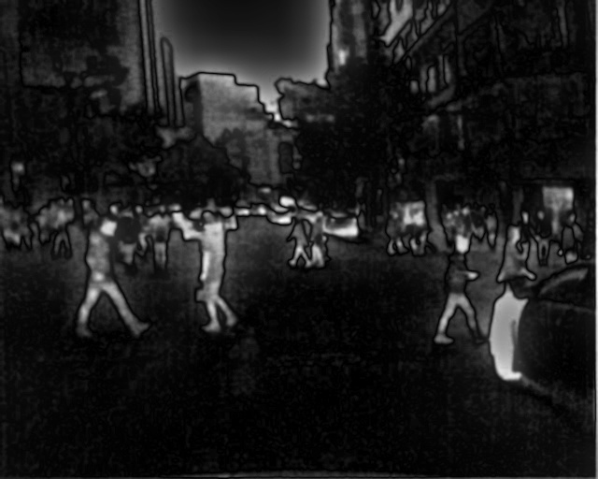
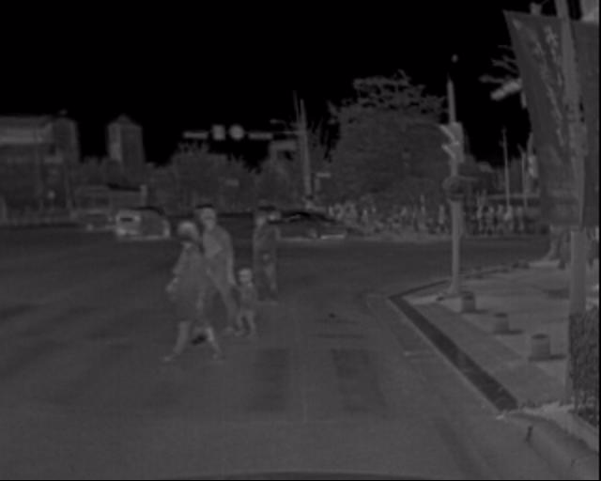

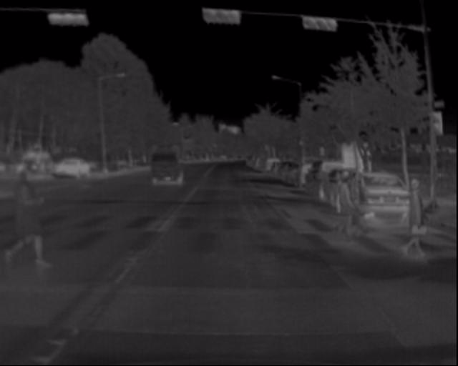
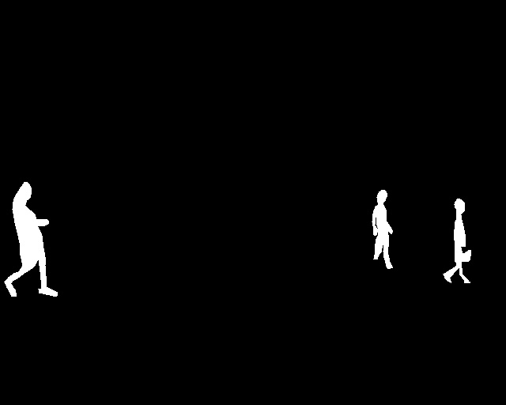
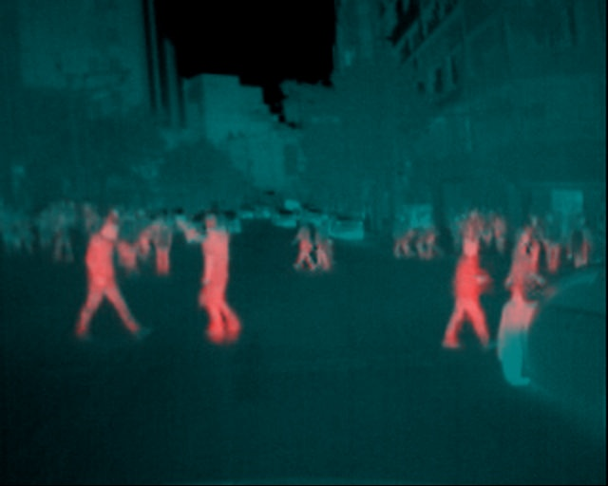
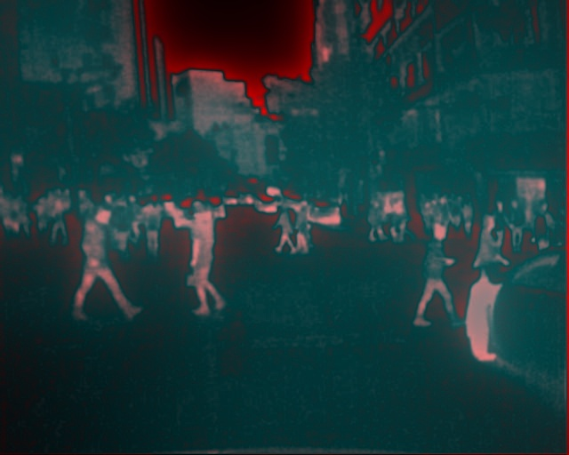
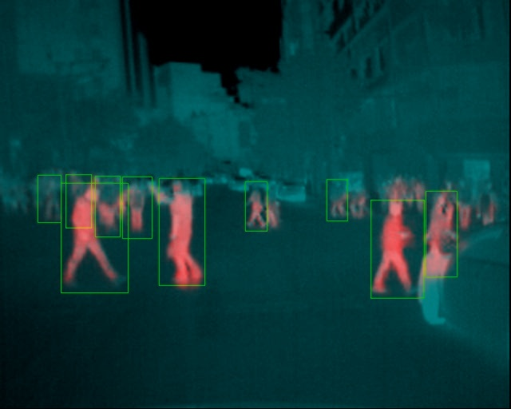
Methods
Saliency Map using OpenCV
Fused Image
Saliency Detector
+
Our Dataset
Thermal Image
Ground Truth Saliency Mask
Saliency Map from Deep Network
Fused Image
Detection
Fused Images
Fused Images
+
Faster RCNN
Faster RCNN

Slide 4
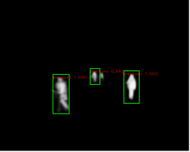
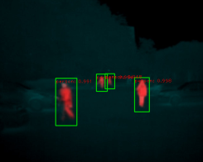
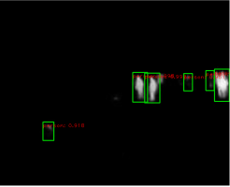
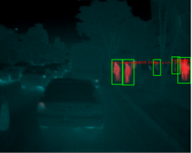
RESULTS
Why not use only Saliency Maps instead of augmenting the Thermal images with Saliency Maps?
Saliency Map
Thermal + Saliency
Saliency Map
Thermal + Saliency
Log Average Miss Rate
0.44
0.39
0.40
0.40
0.32
0.30
0.22
0.21

